Slide 1
Copilot + Power Envisioning & Proof of Concept
Delivery Guide

Slide 2
Version history
Hidden
Version | Changes | Date
25.07 | FY26 initial release | July 2025
25.10 | Content updates, introduction of 5 pathways | Oct 2025

Slide 3


Document purpose
Purpose
The purpose of this document to provide and overview and definition of the new Copilot & Power Envisioning & Proof of Concept engagement. This includes definition of the new approach to delivering the engagement, engagement structure, potential activities, available assets to support delivery activities, and alignment with desired customer outcomes.
This document also provides guidance for engagement preparation, suggested skills needed, customer participants, and other aspects of engagement planning. Consultants delivering this engagement should use this guide to become familiar with engagement delivery details.
Audience
This document is intended to be used by partner sellers, practice leads, project managers, field consultants, and other partner resources with competencies in Microsoft 365 Copilot and Power Platform.
Assumptions
Partner resources involved in the delivery of this engagement have read and understand the content of this delivery guide.
Partner understands that this document is not intended to be shared directly with customers.
Other notes
If you believe you have found an error or correction needed in this document, please complete this form.

Slide 4
Copilot + Power Envisioning & PoC | What’s new!
October 2025 – Wave 2 updates! (v25.10)
Please review the following summary of changes introduced with this release:
Introduction of 5 delivery pathways
With the new, flexible engagement structure – we’ve received feedback around the desire to have recommended delivery patterns. You will now find 5 new pathways that showcase common methods of delivery, including .zip folders containing all relevant assets packaged for that style of delivery.
Pathway 1 - Copilot envisioning
Pathway 2 - Technical & security readiness
Pathway 3 - Copilot + agents proof of concept
Pathway 4 - Power Platform envisioning
Pathway 5 - Power Platform proof of concept
Updated assets and resources
Assets and resources have been updated to reflect product and feature updates where applicable.
New contents include:
Updated product pitch decks
New Security for AI Assessment
Copilot Control System​
Agent Cost Management Resources​
Build Agents in Copilot Studio and Copilot Studio lite​
SharePoint Advanced Management Overview and SharePoint Data Governance in preparation for Copilot deployment​
New Power Platform Decks: Lead in the New Age of AI, Innovate with AI Apps and Agents, Dataverse, Modernize with Intelligent Apps​
New Recommended Prompts for Microsoft 365 Copilot​
Researcher and Analyst Overview Deck
SharePoint agent resources

Slide 5

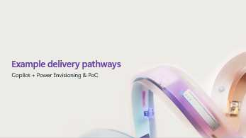






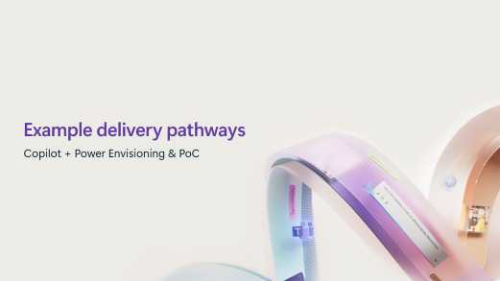




Table of contents
1
4
2
5
Click a section to jump to it
3
6

Slide 6
Engagement summary
Copilot + Power Envisioning & PoC

Slide 7

Copilot + Power Envisioning & PoC
Welcome!
Thanks for taking the time to review this delivery guide for the Copilot + Power Envisioning and PoC engagement!
This engagement is designed to provide you with a flexible and modular approach to driving customer intent as a pre-sales motion. This includes suggested activities and a catalog of supporting assets you can use for engagement delivery.
Please take the time to review this delivery guide and other guidance provided in preparation for leading a successful engagement!

Slide 8
Objectives & outcomes
Copilot + Power Envisioning & PoC
The following represents possible objectives and potential outcomes for delivering this engagement. You may choose to focus efforts in one or more areas or other aspects of envisioning based on your customer’s needs.
Objectives
Show your customers the power of the Copilot + Power.
Discover customers’ unique AI business transformation opportunities.
Develop enablement objectives and target initiatives that align to desired business results.
Target outcomes
Identify customer challenges, opportunities and organizational readiness for AI + Power innovation.
Develop a business case aligned to the customer’s objectives and desired results.
Build an adoption roadmap that focuses on key initiatives and solutions that will drive business value.
A proof of concept that demonstrated the power of AI for business transformation.

Slide 9

Engagement approach
This engagement is flexible and modular. Partners can choose to deliver any combination of activities and utilize any set of resources and assets provided in this guide or use their own assets. This may be based on partner preference, customer requirements or other considerations.
Please see the Copilot + Power Copilot Accelerate Program Guide & MCI Incentive Guide for minimum delivery hours required for funding eligibility.
A reminder: Microsoft’s funding is a co-investment to support Copilot + Power envisioning and/or proof of concept, and is not intended to cover all workshopping, implementation or planning costs.

Slide 10
Copilot + Power Accelerate Program | End-to-end view
DELIVERING PARTNER IMPACT
The Copilot + Power Envisioning & PoC represents the pre-sales portion of the Copilot + Power Accelerate program.
You are here.
PRE-SALES
POST-SALES
Copilot + Power Envisioning & PoC
Copilot + Power Deployment Accelerator
Inspire
Assess
Design
Proof of Concept
Get Ready
Onboard & Engage
Deliver Impact
Extend & Optimize
Pillars
Copilot + Power Accelerate Program Guide

Slide 11

Out of scope
This engagement is not intended to be used for post-sales deployment or adoption.

Slide 12
Planning the engagement
Copilot + Power Envisioning & PoC

Slide 13
Recommended readiness for delivering this engagement
Skills
See the list to the right for a set of technical skills recommended to successfully deliver this engagement.
For non-technical skills, we recommend that the delivery team include a strategic consulting resource that is familiar with facilitating design thinking and envisioning workshops, scenario identification, development of strategic objectives, KPI’s and success metrics, building of business case(s) and value-delivery planning.
Prereading
Review latest product and adoption content available for an understanding of the most current product capabilities.
Recommended prereading includes:
aka.ms/CopilotPartner
Microsoft 365 Copilot Adoption hub
aka.ms/PowerPlatformPartner
Power Platform documentation
Recommended certifications
Power Platform Fundamentals
Power Platform Solution Architect Expert
Recommended technical skills
Strong understanding of the Microsoft 365 Copilot workloads and the current roadmap. Strong understanding of Microsoft 365 Copilot extensibility options and various paths you can take to build agents. Strong understanding of Data, Privacy, and Security for Microsoft 365 Copilot and DSPM for AI. Strong understanding of Power Platform including Power Apps, Power Automate, Power Pages, Dataverse, Copilot Studio and associated technologies. Intermediate understanding of Microsoft 365, Microsoft Teams, responsible AI, Microsoft 365 Security, compliance, and governance. Intermediate understanding of Power Platform administration, governance and security. Intermediate understanding of maker experiences and pro-dev considerations including application lifecycle management (ALM) and extensibility scenarios. In addition, we recommend your team has knowledge in the following areas: Latest trends in AI-enabled business and agents AI-based business process automation Copilot and agents in Power Platform Pro-Developer considerations on Power Platform

Slide 14
Facilitator preparation
Skills & preparation
The skill sets listed to the right are recommended for team member(s) leading and facilitating the delivery of the engagement.
The facilitator should also be familiar with the activities, assets, resources, and outcomes intended to be delivered during the engagement.
The facilitator may also be engaged in the planning and preparation prior to delivery. An example pre-engagement planning deck is available to help facilitate and guide scoping discussions with the customer before you begin envisioning and/or proof of concept.
Recommended soft skills
Understanding of how to discuss Copilot business value, functional go-to-market and how to build a business case for customers. Experience speaking to business decision makers about AI business transformation and scenario/persona discovery. An understanding of the various roles inherent in technology solution development, management and operations. Familiarity with technology solutions development, deployment, and operations methods and practices. Strong experience in global adoption and change management (ACM) and user enablement strategy. Industry knowledge or specific business process knowledge relative to the customer’s environment. Group facilitation experience and skills.

Slide 15
Before the engagement

Slide 16
Identify and engage appropriate roles
It’s important to identify and engage appropriate roles for the Copilot + Power Envisioning & PoC to understand customer business priorities and focus on scenarios that are high-value for the organization.
Project Executive Sponsor, C-Suite or Sr. BDMs (CFO, CMO, COO or relevant business leaders) who can sign off on proposed activities
Business function/department leads and knowledge workers – who can participate in executive interviewing and interactive scenario prioritization, those who know best how their business works day-to-day and what end-user needs are
Change Management or Corporate Communications – integral to successful adoption, content providers, end user training and feedback planning is critical
CIO, ITDM, Enterprise Architects – to provide architecture guidance and insights; technical guidance, visibility into currently deployed technologies and data security considerations
Project Manager/Coordinator – to provide overall engagement project management tasks, end-to-end engagement management
We recommend the following customer roles to attend this engagement:

Slide 17





Who should be engaged
AI Innovation & Transformation Champions
In the Envisioning and PoC phase of the sales journey for Copilot, agents and Power Platform, it is critical to engage both technical decision makers and business decision makers in envisioning and strategy discussions.
While you may engage these audiences in different meetings and experiences, ensuring buy-in and alignment across these audiences is critical for success.
Business & Technical Executives (CxO)
Functional Leaders & Users (HR, Sales, Marketing, etc.)
IT Pros, Security Leads, & Decision Influencers
Adoption Change Management & Corporate Comms Reps
Notes:
AI Transformation & Innovation Leaders

Slide 18
Partner readiness checklist
Get ready for delivering the Copilot + Power Envisioning & PoC by reviewing this delivery guide, identifying assets and resources that you will use, and aligning with your customer to agree on the scope of the engagement.
Pre-engagement checklist
Invest time to familiarize yourself with the delivery guide and engagement content
Research the customer as needed. Discuss any prior conversations with their Microsoft account team to be prepared with an understanding of their current state and AI vision
Review and select resources, assets, templates and other tools from this guide or your catalog of assets to be used during delivery
Keep in mind this is a flexible engagement. You are not required to deliver activities in any particular order. Customize and leverage resources as needed whether you are running envisioning, a proof of concept, or both
Prepare and send any relevant pre-engagement questionnaires
Schedule and facilitate a pre-engagement planning meeting. In the meeting, be sure to:
Confirm customer stakeholders (executive sponsor, department leads, IT stakeholders, etc.)
Define success of the engagement. Determine if you will be conducting envisioning or a proof of concept
Agree on any calls needed with customer to keep track of engagement progress and feedback
Identify which business functions you’ll complete envisioning or a proof of concept with
Agree on the engagement scope, deliverables, and the start date of the engagement
Request necessary trials if you will be running a proof of concept

Slide 19
Copilot + Power Accelerate | available trials
Partners can request specific trials for approved Copilot + Power Accelerate engagements via the Partner-Led Customer Trials Portal at: https://aka.ms/PLGTrialsRequest.
Available partner-led trials include Microsoft 365 Copilot, Copilot Studio, E3, and E5 Compliance
 | Available trial(s) | Terms
Copilot + Power Envisioning & PoC | Microsoft 365 Copilot SKU | Seats: 50 / Length: 60 days
 | Copilot Studio Copilot Studio user license | Seats: 250 / Length: 60 days Seats: 250 / Length: 60 days
 | M365 E3 (no Teams) / M365 E3 EEA (no Teams) M365 E5 Compliance for Partner engagements | Seats: 250 / Length: 120 days (M365 E3 Only) Seats: 250 / Length: 120 days (E5 Comp Only)
Power platform
Copilot + Power Deployment Accelerator | Copilot Studio Copilot Studio user license | Seats: 250 / Length: 60 days Seats: 250 / Length: 60 days
 | M365 E3 (no Teams) / M365 E3 EEA (no Teams) M365 E5 Compliance for Partner engagements | Seats: 250 / Length: 120 days (M365 E3 Only) Seats: 250 / Length: 120 days (E5 Comp Only)
Power platform
Power Platform trials are public
*How to access Power Platform trials - Activate a trial or developer plan license to provide immersive experiences and kickstart customer activation - www.microsoft.com/power-platform/try-free
Nominate customers
Engage customers
Submit Trial Request
Customer engagement
Nominate your customer for the Copilot + Power Accelerate. The approved MCI engagement ID from the nomination will be needed in the trial request.
Review customer’s existing active licenses.
Define clear scope and success criteria.
Review the Trial Guide.
Request the customer trial https://aka.ms/PLGTrialsRequest
Activate trial(s)
Accelerate and realize opportunity

Slide 20
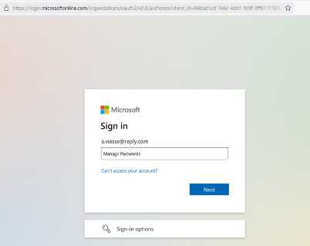
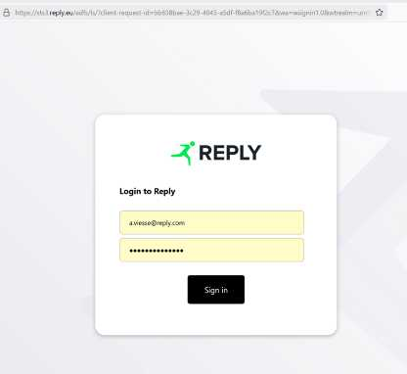
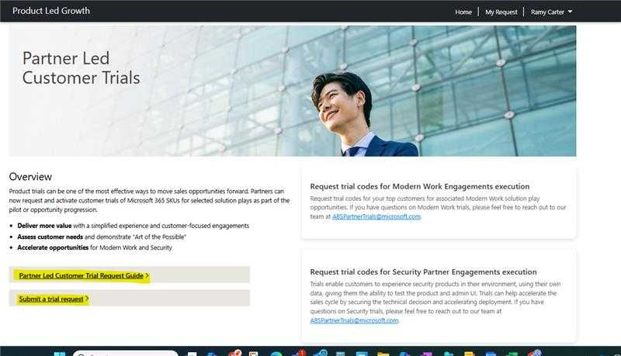
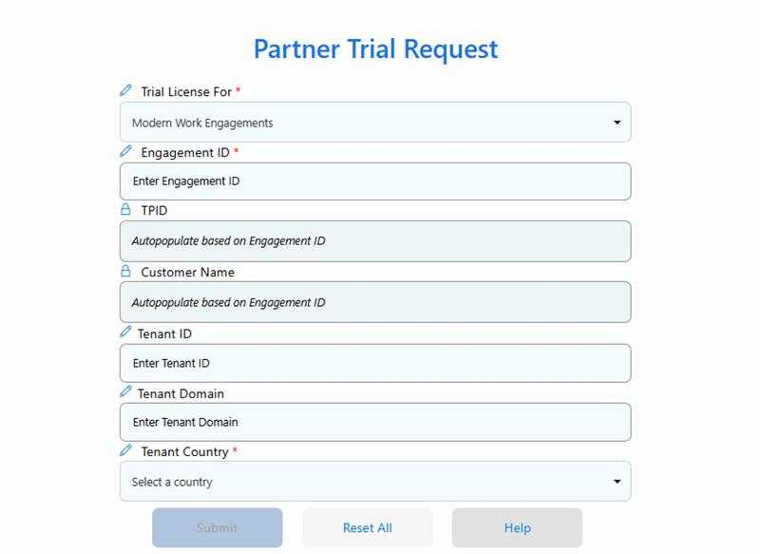
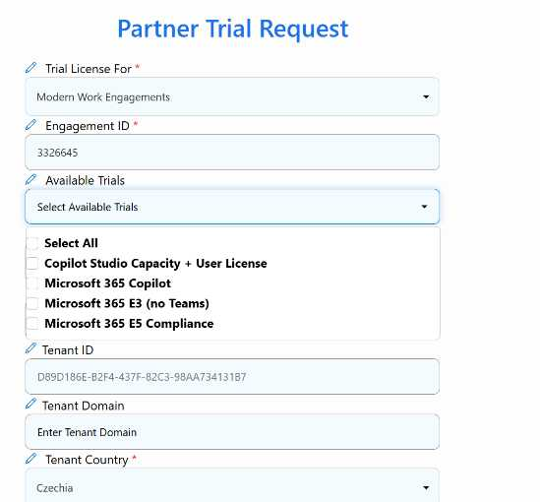
Details on how to request partner-led trials
Visit https://aka.ms/PLGTrialsRequest and sign in using your partner credentials.
Complete the sign-in process to access the portal.
Once signed in, you’ll be directed to the Partner-Led Customer Trials portal. This portal is only visible to authorized partners.
Submit engagement details, fill out required fields including your Engagement ID
After your engagement is validated, you’ll be able to choose from the available trials based on what your engagement allows.
Review your selections, confirm the engagement, and the trials will be distributed accordingly.

Slide 21




How to access Power Platform trials
Activate a trial or developer plan license to provide immersive experiences and kickstart customer activation
Sign up for a free developer account—with no time limits
Get a 30-day free Power Pages trial
Power Apps
Power Pages
Get a 90-day free Power Automate trial
Get a 30-day free Copilot Studio trial
Power Automate
Copilot Studio
www.microsoft.com/power-platform/try-free
*Note – Copilot Studio is available in both the partner-led trial program for a 90-day trial offering and an openly available free 30-day trial. Select what meets the customer best.

Slide 22
Delivering the engagement
Copilot + Power Envisioning & PoC

Slide 23

Engagement pillars
Copilot + Power Envisioning & PoC
The Copilot + Power Envisioning & PoC can be organized into four simple pillars to help you ‘meet the customer where they are.’ and guide the envisioning and/or proof of concept conversations. You do not need to deliver activities in a particular order, but the recommended flow will help with building on prior conversations and achieve a successful engagement that drives intent across Microsoft 365 Copilot, Copilot Chat, Copilot Studio and/or Power Platform. On the following slides, you’ll find activity categories and associated assets and resources aligned to the following four pillars:
Inspire
Assess
Design
Proof of Concept
Showcase the “Art of the Possible” by delivering product overviews, demos and showcasing customer stories with scenario examples.
Discuss AI re-invention and the value of business process optimization, touching on the importance of data security, governance, adoption and change management.
Inspire them to learn how AI-enabled innovation can help increase revenue, optimize costs and develop innovative solutions for customers and employees.
Assess customer’s needs and readiness for AI enabled transformation.
Gain an understanding of the customers current state position in terms of strategy, vision, technical, organizational, and business readiness.
Facilitate executive-level interviews, data analysis and workshopping to identify high-value scenarios across priority departments.
Develop a preliminary business case or value realization plan for the customer.
Define any relevant technical or functional requirements and design needed for a PoC.
Build an adoption roadmap as necessary.
Define next steps and timeline to develop and implement the solution.
Deliver a proof of concept in the customer’s environment, helping them to quickly understanding value and assess feasibility for implementing AI.

Slide 24
Overview
Engagement Delivery Structure
The diagram below is provided to illustrate the engagement structure. Definitions of each activity category can be found on the following slide.
Engagement
What is an Activity category? Activity categories are used as a grouping mechanism for Activities, allowing partners to easily determine sets of related activities and associated assets.
Activities
What is an Activity? Activities are efforts conducted to drive the customer forward in the implementation and adoption process.
Activity category 1
Activity
Supporting assets
What is a supporting asset? Activities are associated with Assets & resources of all types, such as pitch decks, templates, tools, questionnaires, guides, demo assets, sample data, training resources, reference libraries, and other curated resources that can be used by the partner to support delivery of an Activity. Partners may use one or more assets and resources to support an Activity or use their own methods and resources.
Activity
Activity category 2
Activity
Activity
Asset 1
Asset 2
Asset 3

Slide 25
Activity category definitions
Engagement Delivery Structure
Review the seven activity categories and their definitions to understand how we have defined them.
Activity category | Activity category definition
Project & Engagement Management | This category includes project and engagement management activities like pre-engagement planning, stakeholder identification, engagement logistics, coordination, and administrative tasks like customer nominations, surveys, and engagement completion reporting.
Business Value Analysis, Measurement, & Reporting | This category includes activities across the end-to-end value stream, such as defining methods to qualify and quantify value, setting business objectives, establishing value metrics, measuring cost and value, and realizing value outcomes.
Scenario Discovery & Solution Design | This category includes activities related to the process of identifying and prioritizing high-value business scenarios that can unlock further potential with Microsoft 365 Copilot, Copilot Chat, agents and Power Platform.
Agents, Solutions & Initiatives Development | This category includes activities related to the technical design, development, testing, and deployment of a service, agent, application, automation, or non-technical initiative designed to deliver business value.
Security, Compliance & Governance | This category includes activities related to the delivery of information, planning, configuration, development, setup, and technical deployment activities in support of security, compliance, and governance frameworks, technologies, reporting and operations.
Administration & Operations | This category includes activities related to the administration, operations, setup, configuration, monitoring, and maintenance of a platform, a service, cloud infrastructure, platform and application features and other elements which require ongoing administration.
Immersion, Training & Adoption | This category includes activities related to the transfer of knowledge, learnings, skills, and capabilities to Champions, end users, administrators, and other stakeholders – ultimately driving greater adoption and utilization of a platform, service, solution, or technical capability.

Slide 26
Categories & activities

Slide 27
Engagement activities
Below is a list of proposed example activities, organized by activity category and engagement pillar. Activities may be selected based on customer need and alignment to the outcomes you intend to drive. Activities may be supported by one or more assets provided or you may choose to use your own assets and resources.
 | Inspire | Assess | Design | Proof of Concept (PoC)
01 Project & Engagement Management | Review delivery guide & engagement assets Pre-engagement planning | Determine which assessments will be run | Deliver executive summary | Identify IT Admin and prepare access to the environment
02 Business Value Analysis, Measurement, & Reporting | Deliver high level overview of reporting & analytics capabilities | Define success | Develop an initial business case Build a value realization plan | Measure proof of concept results
03 Scenario Discovery & Solution Design | Showcase the Microsoft Scenario Library | Determine high-value scenarios, solutions or initiatives | Define the scope of the proof of concept
04 Agents, Solutions & Initiatives Development | Deliver demos |  | Define technical/functional requirements and design | Build proof of concept agent or solution
05 Security, Compliance & Governance | Deliver Security & Governance overview | Run Security for AI Assessment Run oversharing assessment | Plan remediation
06 Administration & Operations |  | Deliver readiness assessments | Prepare environment for proof of concept | Enable trial license(s)
07 Immersion, Training & Adoption | Deliver product overviews, customer stories and case studies Deliver ACM best practices |  | Build adoption roadmap | Provide training to proof of concept users

Slide 28
Assets & resources by activity category

Slide 29
Activity category 01 | Project & Engagement Management
Activities & supporting Assets
Activity | Implementation pillar | Activity description | Assets & resources
Review delivery guide & engagement assets | Inspire | Review the delivery guide to understand activity categories and assets. Choose relevant ones for envisioning or proof of concept. Skill up for delivery and sync with the Microsoft team on prior customer engagement. | Copilot + Power Envisioning & PoC Delivery Guide Facilitators Guide – Understanding OKR’s
Pre-engagement planning | Inspire | Identify key business and functional leaders to partner with IT on AI use cases. Nominate executive sponsors with your AI Council and define success metrics. | Copilot + Power Pre-engagement planning Copilot - Pre-Engagement Questionnaire Copilot - How To Engage Functional Business Leaders Power Platform Pre-Engagement Questionnaire
Determine which assessments will be run | Assess | Align with the customer and agree which assessment activities will be performed. | Copilot + Power Pre-engagement planning
Identify IT admin and prepare access to the environment | Proof of concept | If delivering a proof of concept, ensure you have alignment with the customer to access their Microsoft 365 admin environment for setup and configuration. | Copilot + Power Pre-engagement planning
Deliver executive summary | Design | Prepare the executive readout which includes, summarized findings and results. In addition, in collaboration with the main stakeholders create an AI roadmap to help the customer grow beyond the engagement. | Use your own executive summary template or outputs from 02 - Business Value or 03 – Scenario Discovery & Solution Design

Slide 30
Activity category 02 | Business Value Analysis, Measurement, & Reporting
Activities & supporting Assets
Activity | Implementation pillar | Activity description | Assets & resources
Deliver overview of reporting & analytics capabilities | Inspire | Help the customer understand what reports and tools are available to measure usage and impact. | Microsoft Copilot Analytics Overview Copilot Analytics introduction Copilot Control System Pitch Copilot Analytics: Accelerating Risk & Compliance Discussion Guide
Define success | Assess | Align with the customer and agree on the scope and success criteria of the envisioning & proof of concept engagement. | Copilot + Power Pre-engagement planning Power Platform Pre-Engagement Questionnaire Power Platform – Build the Vision
Develop an initial business case | Design | Use tools to develop a measurable business case, justifying the investment in Microsoft 365 Copilot and/or Power Platform. This may include KPIs, OKRs or other success metrics and value framework elements. | Business Case Builder for Microsoft 365 Copilot Microsoft 365 Copilot and Chat Value Envisioning Tool (VET) Copilot Studio Cost Estimator Power Platform – Build the Vision Forrester Total Economic Impact of Microsoft Power Apps
Build a value realization plan | Design | Develop a business value realization plan based on the objectives, key results, and initiatives identified by documenting quantifiable measures and timeframes for realizing value from the platform. | Power Platform – Build the Vision Power Platform – Business Value Toolkit
Measure proof of concept results | Proof of Concept | After the PoC, use available reports and analytics to show impact, adoption, and how these support business value and future planning. | Connect to the Microsoft Copilot Dashboard Assess Copilot Impact Power Platform – Build the Vision Power Platform - Analyze App and Agent Usage in Developer Portal

Slide 31
Activity category 03 | Scenario Discovery & Solution Design
Activities & supporting Assets
Activity | Implementation pillar | Activity description | Assets & resources
Showcase the Microsoft Scenario Library | Inspire | Share pre-built functional and industry scenarios with your customer to help inspire them to understand the art of the possible before diving into scenario and solution workshopping. | Microsoft Scenario Library Copilot Studio 35 Scenarios
Determine high-value scenarios, solutions or initiatives | Assess | Work with the project sponsor to identify business areas and user groups to be included to identify key scenarios and solutions and confirm participation. Use the relevant design thinking and envisioning frameworks (i.e. value/complexity matrix, strategic value scoring, OKRs, or other scenario value analysis method) to prioritize scenarios. | Copilot Scenario Analysis & Prioritization Power Platform – Build the Vision
Define the scope of the proof of concept | Design | Align with the customer on what will be deployed during the proof of concept, including any relevant adoption or training activities. | Copilot + Power Pre-engagement planning Power Platform - Solution Definition & Design

Slide 32
Activity category 04 | Agents, Solutions & Initiatives Development
Activities & supporting Assets
Activity | Implementation pillar | Activity description | Assets & resources
Deliver demos | Inspire | Deliver key product demos to showcase the value of Microsoft 365 Copilot, Copilot Chat, agents, Copilot Studio & Power Platform. | Copilot Studio Demo Setup Guide Copilot Studio Agent demo resources Microsoft 365 Copilot Demo YouTube Playlist MDX - Microsoft Demo eXperiences Power Platform Demo Videos and Guided Tours
Define technical/functional requirements | Design | Elaborate on priority scenarios, distill the scenarios into stories or requirements and elaborate on priority stories as needed for proof of concept readiness. | Copilot + Power Solution Definition & Design Copilot - Empowering Responsible AI Practices Copilot - Microsoft 365 Copilot Extensibility Planning Guide Copilot – Agent Cost Management Resources Power Apps Design Best Practices from Power CAT
Build a proof of concept agent or solution | Proof of Concept | Build and deploy proof of concept agents and/or solutions. | Agents for Microsoft 365 Copilot Chat Copilot Studio - Build Agents Overview Build Agents in Copilot Studio lite Build Agents in Copilot Studio Copilot - End To End 5 Agent Scenarios: IT, HR, Customer Service, Marketing & Sales Power Platform - Implementation Guide Power Platform - Build & Deploy

Slide 33
Activity category 05 | Security, Compliance & Governance
Activities & supporting Assets
Activity | Implementation pillar | Activity description | Assets & resources
Deliver security & governance overview | Inspire | This executive-level discussion is designed to align stakeholders on the organization’s approach to data security, governance, and access management in the context of AI and Copilot adoption. | Secure AI Transformation - L50 Secure and Govern Microsoft 365 Copilot - L100 Secure and Govern Microsoft 365 Copilot - L150 SharePoint Advanced Management Overview SharePoint Data Governance Agent Governance whitepaper Copilot Agent Governance & Controls Copilot Studio Governance Security & Administration Power Platform - Governance & Security Power Platform – Design Secure & Compliant Governance
Run Security for AI Assessment | Assess | This tool provides recommendations to enhance your AI security posture based on the information you provide. Accuracy of results depends on the accuracy of your input. The report is for informational purposes only and does not guarantee performance or outcomes. It should not be interpreted as a commitment from Microsoft. Actual results may vary based on factors such as location, purchase method, and usage. Microsoft makes no express or implied warranties regarding the content of this report or website. | Security for AI Assessment
Run oversharing assessment | Assess | Complete applicable security assessments for the customer to provide a baseline of their existing security maturity and discuss next steps and actions required to remediate any critical blockers. | Data Security for Copilot Assets Microsoft Purview Data Security And Compliance Protections For Microsoft 365 Copilot & Other Generative AI Apps
Plan remediation | Design | Develop a plan to remediate any urgent security and governance issues prior to proof of concept and/or moving into deployment. | Microsoft 365 Copilot Blueprint For Oversharing Copilot Studio - Governance & Security Best Practices Overview
Notes:
5 assets

Slide 34
Activity category 06 | Administration & Operations
Activities & supporting Assets
Activity | Implementation pillar | Activity description | Assets & resources
Deliver readiness assessments | Assess | Work with the customer to assess their readiness to adopt Microsoft 365 Copilot, Copilot Chat, agents, Copilot Studio and/or Power Platform. | Security for AI Assessment Power Platform Adoption Assessment
Prepare environment for proof of concept | Design | Get ready and prepare the customer’s tenant with setup and configuration in preparation for the proof of concept. | Copilot Implementation summary guide Copilot Technical Readiness Guide Set Up Your Development Environment to Extend Microsoft 365 Copilot Set up Microsoft 365 Copilot Copilot Chat IT Controls Guide Manage Copilot Studio messages and capacity Power Platform - Environments Overview
Enable trial license(s) | Proof of Concept | Request and enable relevant trial license(s) to run a proof of concept in the customer’s production tenant. | N/A
Notes:
1 to 2

Slide 35
Activity category 07 | Immersion, Training & Adoption
Activities & supporting Assets
Activity | Implementation pillar | Activity description | Assets & resources
Deliver product overviews, customer stories and case studies | Inspire | Deliver key product overviews to showcase the value of Microsoft 365 Copilot, Copilot Chat, agents, Copilot Studio, & Power Platform. | Cross-Platform Lead in the New Age of AI Copilot - Microsoft 365 Copilot Customer Pitch Deck Copilot - Copilot Chat Pitch Deck Copilot Studio - Agents Vision Copilot - Extend Microsoft 365 With Copilot Agents Copilot - Building Agents with Microsoft Copilot - Researcher and Analyst Overview Copilot – SharePoint agents resources Copilot Studio - Hero Pitch Deck Copilot Studio - TDM Pitch Deck Copilot Studio - Demo Setup Guide Copilot Studio - Demo Assets Guide Power Platform - Innovate with AI Apps and Agents Power Platform - Modernize with Intelligent Apps Power Platform - Dataverse TDM Pitch Deck Power Platform real-world case studies Microsoft Power Platform & Copilot Studio Stories
Deliver ACM best practices | Inspire | Help your customer understand the importance of an effective adoption and change management campaign to drive a successfully proof of concept and/or deployment within enterprise organizations. | Accelerate Copilot enablement with Microsoft Viva Copilot Adoption Hub Power Platform Adoption Hub Power Platform Adoption Planning Workbook
Build adoption roadmap | Design | Build a plan for adoption if delivering a proof of concept. | Copilot - Launch Day Kit Copilot Chat Success Kit Copilot Success Kit Copilot - Agents Success Kit Copilot Adoption Planning Checklist Power Platform Adoption Planning Workbook
Provide training to proof of concept users | Proof of Concept | Train end users on key product features to improve workflows, and build skills in prompting, AI, and automation. | Microsoft 365 Copilot user engagement tools and templates Copilot - User Enablement Guide Copilot - Executive Immersion Experience Copilot - Learn How To Prompt Copilot - Recommended Prompts for Microsoft 365 Copilot Copilot - Prompt-a-thon Copilot - End User Lunch & Learn Sessions Power Platform Adoption Planning Workbook
Notes:
4 to 5 assets

Slide 36
Checklists by pillar

Slide 37
Inspire pillar checklist
Showcase the “Art of the Possible” through demos, customer stories, and real-world scenarios. Explore AI-driven transformation, business process optimization, and the essentials of data security, governance, and change management.
Inspire
Deliver product overviews:
Microsoft 365 Copilot
Copilot Chat
Agents
Copilot Studio
Power Platform
Other:
Deliver security & governance overview
Deliver adoption and change management overview
Deliver overview of reporting & analytics capabilities
Show demos, share customer stories, review industry trends
Showcase the Microsoft Scenario Library
Other:

Slide 38
Assess pillar checklist
Evaluate customer needs and AI readiness through technical, security, and organizational assessments. Use executive interviews, data analysis, and workshops to identify high-value scenarios across priority departments.
Assess
Determine which assessment will be run
Define success
Deliver readiness assessments
Security for AI Assessment
Power Platform Adoption Assessment
Other technical or organizational readiness assessment(s)
Identify high-value scenarios, solutions or initiatives
Run oversharing assessment with Microsoft Purview
Other:

Slide 39
Design pillar checklist
Develop a business case or value realization plan for the customer. Define any relevant technical or functional requirements and design needed for PoC. Build adoption roadmap as necessary. Define next steps and timeline to develop and implement the solution.
Design
Develop an initial business case
Build a value realization plan
Develop a remediation plan as needed
Define technical/functional requirements for agents, solutions, non-technical initiatives
Build an adoption roadmap
Define success criteria for a PoC
Prepare environment for proof of concept
Deliver executive summary, including recommendations on next steps, risks, owners, and estimated completion dates
Other:

Slide 40
Proof of Concept pillar checklist
Deliver a proof of concept in the customer’s environment, helping them to quickly realize value and assess feasibility of implementing AI for their organization.
Proof of Concept
Define the scope of the proof of concept, which users will participate and what products/features will be evaluated
Confirm proof of concept requirements and define design
Identify IT admin and prepare access to the environment
Request and enable trial licenses
Build a proof of concept agent(s) or solution(s), and enable key features
Provide training to proof of concept users
Measure and evaluate proof of concept results
Other:

Slide 41
Example delivery pathways
Copilot + Power Envisioning & PoC

Slide 42
Delivery pathway examples
Given the flexible and modular nature of this engagement, we've put together a few sample delivery approaches. These examples demonstrate how you can tailor the engagement style, assets, and resources to meet your customer's specific needs. They are intended as recommendations and can be customized as needed.

Slide 43

Copilot envisioning
Example delivery – Pathway 1
Access the Pathway 1 .zip including decks at https://aka.ms/CopilotPower-EnvisioningPoC-Pathway1. We recommend each engagement begin with leveraging the Copilot + Power Envisioning & PoC Delivery Guide and Pre-Engagement Planning decks
Your customer is new to AI and would like a full envisioning workshop, starting with understanding what is possible with Microsoft 365 Copilot, participating in scenario discovery to dig into function usability, and ending with an initial business case to help justify the investment.
Inspire
Assess
Design
Proof of Concept
Deliver product overviews, customer stories and case studies:
Microsoft 365 Copilot Customer Pitch Deck
Copilot Chat Pitch Deck
Extend Microsoft 365 With Copilot Agents
Copilot - Building Agents with Microsoft
Deliver demos:
MDX - Microsoft Demo eXperiences
Show demos & scenario library:
Microsoft Scenario Library
Copilot Studio 35 Scenarios
Determine high-value scenarios, solutions or initiatives:
Copilot Scenario Analysis & Prioritization
Deliver an initial business case:
Business Case Builder for Microsoft 365 Copilot
Microsoft 365 Copilot and Chat Value Envisioning Tool (VET)
Deliver executive summary
N/A – envisioning only

Slide 44
Technical & security readiness for Copilot
Example delivery – Pathway 2
Access the Pathway 2 .zip including decks at https://aka.ms/CopilotPower-EnvisioningPoC-Pathway2. We recommend each engagement begin with leveraging the Copilot + Power Envisioning & PoC Delivery Guide and Pre-Engagement Planning decks
Your customer has concerns about their security and governance posture and needs your help to understand the capabilities available with Microsoft 365 to secure and govern before making their investment into Microsoft 365 Copilot.
Inspire
Assess
Design
Proof of Concept
Deliver security & governance overview:
Secure AI Transformation - L50
Secure and Govern Microsoft 365 Copilot - L100
Secure and Govern Microsoft 365 Copilot - L150
SharePoint Advanced Management Overview
SharePoint Data Governance
Agent Governance whitepaper
Copilot Agent Governance & Controls
Run Security for AI Assessment:
Security for AI Assessment
Run oversharing assessment:
Copilot - Data Security Assets
Plan remediation:
Review and discuss results for remediation and unblocking license purchase for M365 Copilot
Microsoft 365 Copilot Blueprint For Oversharing
Copilot Studio - Governance & Security Best Practices Overview
Deliver executive summary
N/A – security focused engagement

Slide 45
Copilot + agents proof of concept
Example delivery – Pathway 3
Access the Pathway 3 .zip including decks at https://aka.ms/CopilotPower-EnvisioningPoC-Pathway3. We recommend each engagement begin with leveraging the Copilot + Power Envisioning & PoC Delivery Guide and Pre-Engagement Planning decks
Your customer has already discussed and seen product overviews of Copilot + agents. They are ready to jump right into a lightweight proof of concept and build their first agent with you.
Inspire
Assess
Design
Proof of Concept
N/A – past the inspiration pillar, jumping to Design/PoC delivery
N/A – past the assess pillar, jumping to Design/PoC delivery
Define scope of the proof of concept
Define technical/functional requirements and design:
Copilot + Power Solution Definition & Design
Copilot - Agent Cost Management Resources
Prepare environment for proof of concept:
Copilot Implementation summary guide
Copilot Technical Readiness Guide
Set up Microsoft 365 Copilot
Manage Copilot Studio messages and capacity
Identify IT Admin and prepare access to the environment
Enable trial license(s)
Build a proof of concept agent or solution:
Agents for Microsoft 365 Copilot Chat
Copilot Studio - Build Agents Overview
Build Agents in Copilot Studio lite
Build Agents in Copilot Studio
Copilot - End To End 5 Agent Scenarios: IT, HR, Customer Service, Marketing & Sales
Provide training to proof of concept users:
Microsoft 365 Copilot Chat and agent starter kit
Copilot Success Kit
Microsoft 365 Copilot user engagement tools and templates
Copilot - Executive Immersion Experience
Copilot - Learn How To Prompt
Recommended Prompts for Microsoft 365 Copilot
Copilot - End User Lunch & Learn Sessions
Measure proof of concept results

Slide 46
Power Platform envisioning
Example delivery – Pathway 4
Access the Pathway 4 .zip including decks at https://aka.ms/CopilotPower-EnvisioningPoC-Pathway4. We recommend each engagement begin with leveraging the Copilot + Power Envisioning & PoC Delivery Guide and Pre-Engagement Planning decks
Your customer understands the capabilities of Power Platform and wants to define the path forward to ensure they are effectively prepared to deliver business value from the platform prior to implementation.
Inspire
Assess
Design
Proof of Concept
N/A – past the inspiration pillar, beginning with assessment
Determine which assessments will be run
Define success:
Power Platform Pre-Engagement Questionnaire
Determine high-value scenarios, solutions or initiatives:
Power Platform – Build the Vision
Deliver readiness assessments:
Security for AI Assessment
Power Platform Adoption Assessment
Develop an initial business case:
Forrester Total Economic Impact of Microsoft Power Apps
Build a value realization plan:
Power Platform – Business Value Toolkit
Build adoption roadmap:
Power Platform Adoption Planning Workbook
Deliver executive summary
N/A – engagement focused on solution envisioning for Power Platform

Slide 47
Power Platform proof of concept
Example delivery – Pathway 5
Access the Pathway 5 .zip including decks at https://aka.ms/CopilotPower-EnvisioningPoC-Pathway5. We recommend each engagement begin with leveraging the Copilot + Power Envisioning & PoC Delivery Guide and Pre-Engagement Planning decks
Your customer is committed to moving forward with the Microsoft Power Platform for low-code development and wants to deliver some initial solutions for review and feedback.
Inspire
Assess
Design
Proof of Concept
N/A – past the inspiration pillar, jumping to Design/PoC delivery
N/A – past the assess pillar, jumping to Design/PoC delivery
Define scope of the proof of concept:
Power Platform - Build the Vision
Define technical/functional requirements and design:
Power Apps Design Best Practices from Power CAT
Power Platform - Solution Definition & Design
Prepare environment for proof of concept:
Power Platform - Environments Overview
Build adoption roadmap:
Power Platform Adoption Planning Workbook
Identify IT Admin and prepare access to the environment
Enable trial license(s)
Build a proof of concept agent or solution:
Power Platform - Implementation Guide
Power Platform - Build & Deploy
Provide training to proof of concept users:
Power Platform Adoption Planning Workbook
Measure proof of concept results
Power Platform - Build the Vision

Slide 48
Engagement completion
Copilot + Power Envisioning & PoC

Slide 49
Delivery completion
At the conclusion of the Copilot + Power Envisioning & PoC engagement, we recommend delivering an executive summary presentation—ideally attended by business sponsors, IT, and key stakeholders.
Suggested agenda:
Recap scope, goals, and engagement outcomes
Present strategic recommendations and value alignment
Review additional suggestions and next steps
Collect feedback on the engagement delivery
Important:
Both you and the customer will receive a mandatory Microsoft survey to confirm engagement completion and unlock incentive funding. Please follow up with your customer to ensure timely submission and payout eligibility.
You may share the executive summary and any other deliverables with the customer at this time.

Slide 50
Resources

Slide 51
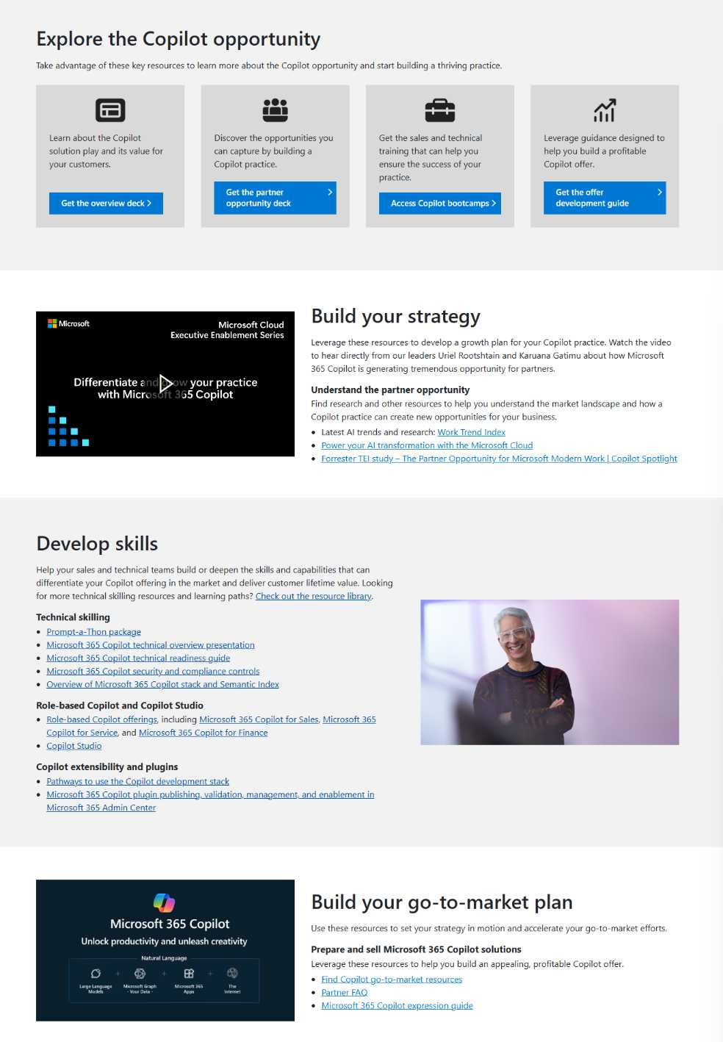
Scale up your Copilot expertise with the Copilot Partner Practice Development Portal
https://aka.ms/CopilotPartner and https://aka.ms/PowerPlatformPartner
Access clear, actionable guidance to help you build or extend your business with including Microsoft 365 Copilot, Copilot Studio and Copilot agents.
Build your strategy: understand the latest AI trends, market research and partner opportunity information to help shape how you will build and grow your Microsoft 365 Copilot practice.
Develop skills: leverage technical training resources, learning paths, product documentation, and customer pitch decks to deepen your seller’s and consultant's skills and capabilities with Microsoft 365 Copilot.
Build your go-to-market plan: accelerate your go-to-market efforts with marketing campaign materials, offer development and publishing guidance, seller guidance, FAQs and more.

Slide 52
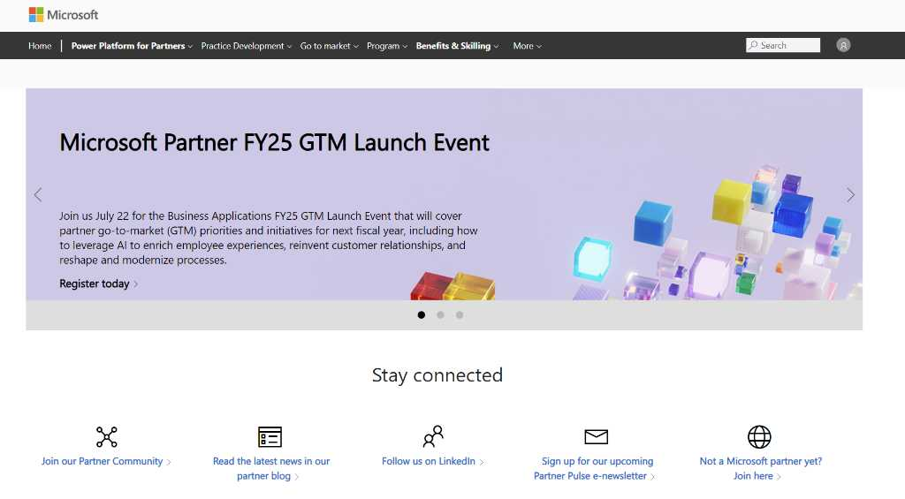
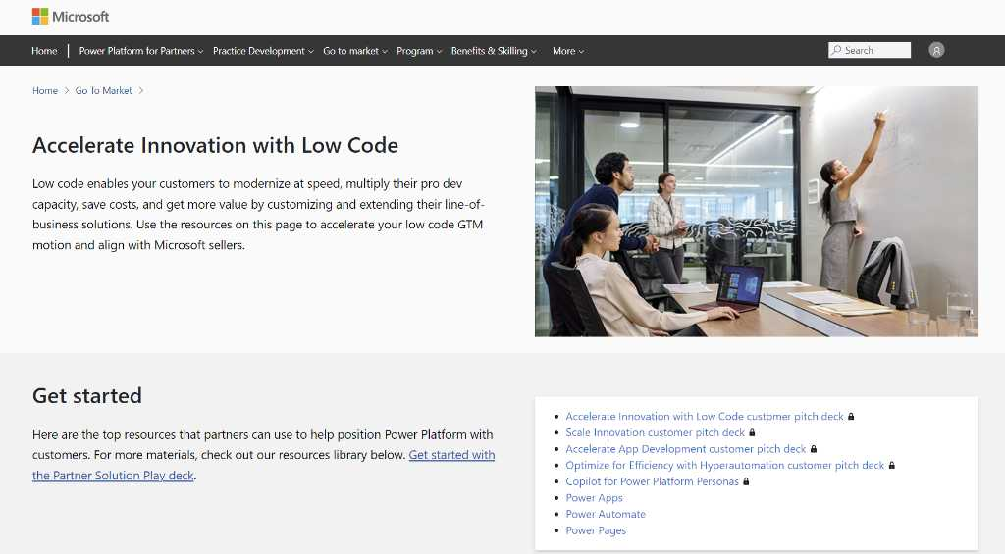
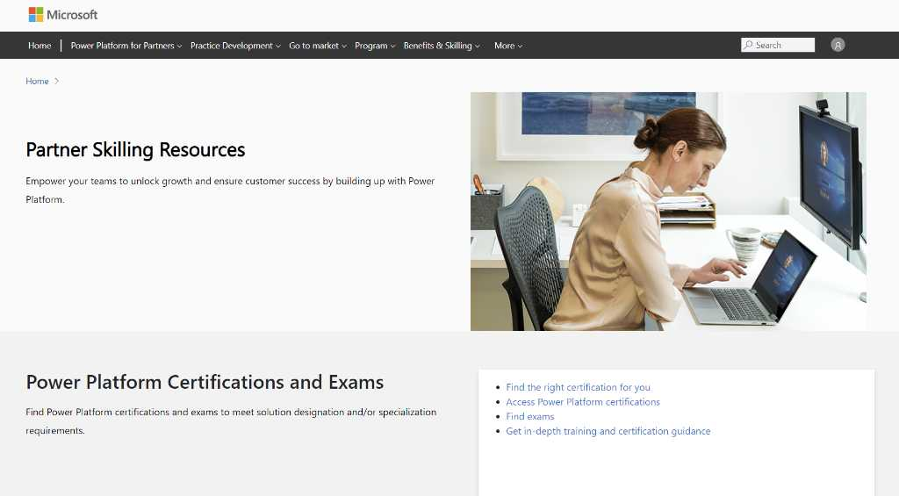
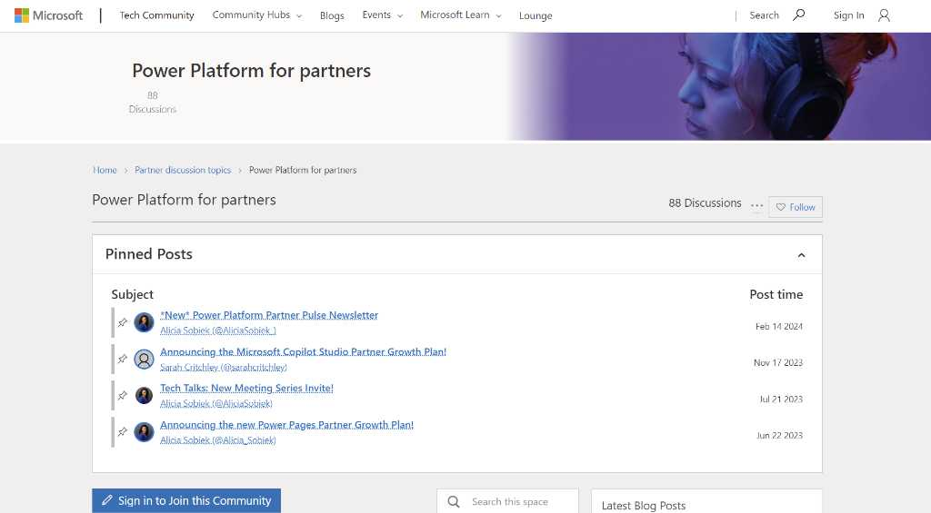
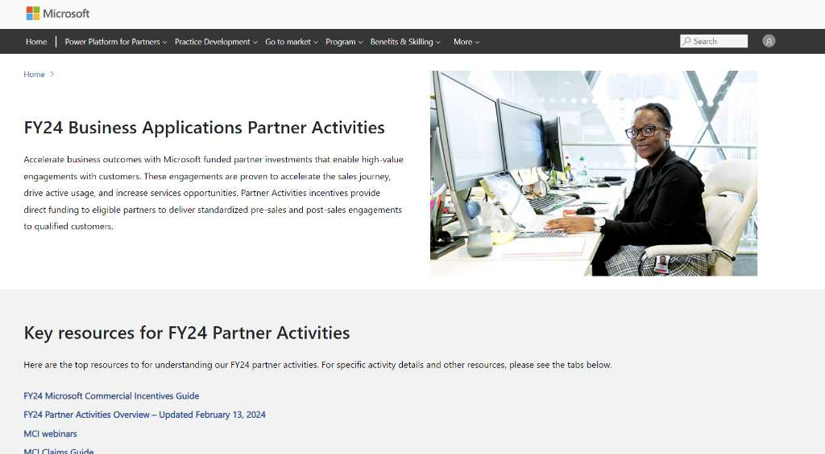
Power Platform Partner Resources
Power Platform Partner Hub
Power Platform Go To Market Resources
Partner Skilling Resources
Power Platform Partner Tech Community
Business Applications Partner Activities

Slide 53




Learn more about Copilot in Power Platform
Demos from Power CAT
Power Platform AI Copilot
Copilot in Power Apps
Copilot in Power Automate
Microsoft Copilot Studio

Slide 54

We look forward to your feedback!
Thank you for your continued trust and partnership. The resources within this toolkit will be iteratively improved upon based on product releases as well as direct feedback from delivered engagements. We encourage you to provide feedback to help us improve our products and toolkits. Please provide your feedback through the following link:
aka.ms/PartnerEngagementFeedback

Slide 55
Thank you

Slide 56
Close

